Slide 1
IEEE
Transactions
on
Cognitive
Communication
and
Networking,
(TCCN)
JUNE 2018
Deep Reinforcement Learning for Dynamic
Multichannel Access in Wireless Networks
Shangxing Wang, Hanpeng Liu, Pedro Henrique Gomes, Bhaskar Krishnamachari
(Department of Electrical Engineering, University of Southern California, Los Angeles, CA, USA)

Slide 2
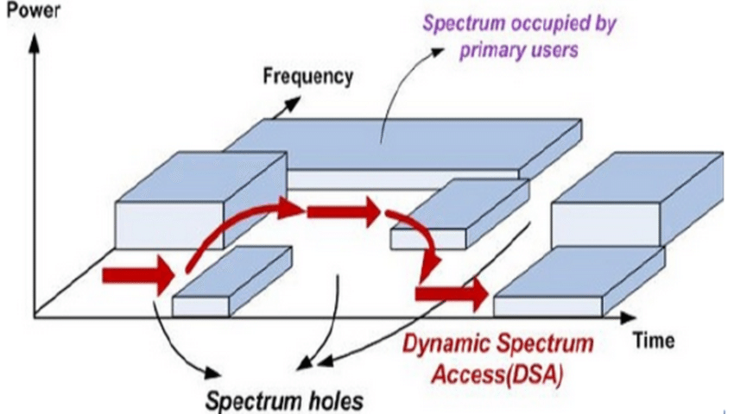
Intro
Dynamic multichannel access
Dynamic spectrum access is one of the keys to improving the spectrum utilization in wireless networks and meeting the need for more capacity.
In the context of cognitive radio research, a standard
assumption has been that secondary users may search
and use idle channels that are not being used by their primary users (PU).
PU
While prior work has generally assumed a simple
independent-channel (or PU activity) model, in practice external interference can cause the channels in wireless networks to be highly correlated, and the design of new algorithms and schemes in dynamic multichannel access is required to tackle this challenge.
A multichannel access problem with $N$ correlated channels. Each channel has two possible states: good or bad, and their joint distribution follow a $2^{N}$ states Markovian model.
There is a single user (wireless node) that selects one channel at each time slot to transmit a packet. . The goal is to obtain as many successful transmissions as possible over time.
As the user is only able to sense his selected channel at each time slot, there is no full observation of the system available.
In general, the problem can be formulated as a partially observable Markov decision process (POMDP)
Notes:
In the context of cognitive radio research, a standard assumption has been that secondary users may search and use idle channels that are not being used by their primary users (PU).

Slide 3
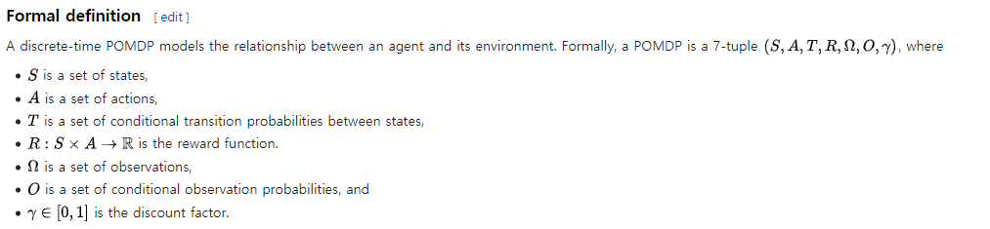
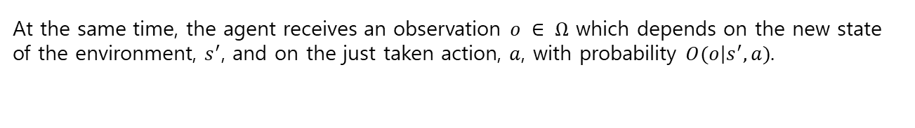
Intro
Our problem falls into the framework of POMDP because of the limit of the partial observation.
POMDP (Partially Observable Markov Decision Process)
A POMDP models an agent decision process in which it is assumed that the system dynamics are determined by an MDP, but the agent cannot directly observe the underlying state.
Instead, it must maintain a probability distribution over the set of possible states, based on a set of observations and observation probabilities, and the underlying MDP.
#Wikipedia-POMDP
At the same time, the agent receives an observation $o ∈ Ω$ which depends on the new state of the environment, $s^{′}$, and on the just taken action, $a$, with probability $O(\left.o\right|s^{′}, a)$.
After having taken the action $a$ and observing $o$, an agent needs to update its belief in the state the environment may (or not) be in. Since the state is Markovian (by assumption), maintaining a belief over the states solely requires knowledge of the previous belief state, the action taken, and the current observation.

Slide 4



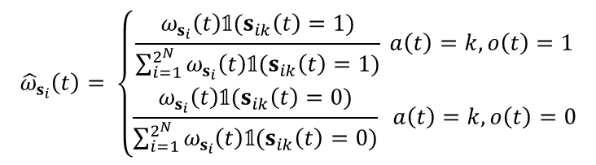

Problem
Formulation
Dynamic multichannel access
We investigate the use of Deep Reinforcement Learning, in particular, Deep Q learning, from the field of machine learning as a way to enable learning in an unknown environment as well as overcome the prohibitive computational requirements.
We implement a DQN that can find a channel access policy through online learning.
POMDP model
State : To model correlation across channels, the whole system is described as a $2^{N}$-state Markov chain.
$S=\{s_{1},s_{2}$, …, $s_{2^{N}}\}$
$s_{i∈\{1, …, 2^{N}\}}$→ length-$N$ vector $[s_{i1}, …,s_{iN}\}$
$s_{ik }$: Binary representation of the state of channel $k$: good(1) or bad(0).
* The transition of the Markov chain is denoted as $P$.
Since the user can only sense one channel at the beginning of each time slot, the full state of all channels is not observable.
Action : Given sensing action $a\left(t\right)∈\left\{1, …, N\right\}$ representing which channel to sense at time slot $t$.
Observation : Represent the belief vector maintained by the user.
The user can observe the state of channel denoted as 𝑜(𝑡) ∈ {0, 1}.
$Ω\left(t\right)=[ω_{s_{1}}(t)$, …, $ω_{s_{2^{N}}}(t)]$
$ω_{s_{i}}(t)$ : is the conditional probability that the system is in state $s_{i}$
given all previous decisions and observations.
$${\hat{ω}}_{s_{i}}\left(t\right)= \left\{\begin{aligned}\frac{ω_{s_{i}}\left(t\right)𝟙{(s}_{ik}\left(t\right)=1)}{\sum_{i=1}^{2^{N}}{ω_{s_{i}}\left(t\right)𝟙{(s}_{ik}\left(t\right)=1)}} a\left(t\right)=k, o\left(t\right)=1 \\ \frac{ω_{s_{i}}\left(t\right)𝟙{(s}_{ik}\left(t\right)=0)}{\sum_{i=1}^{2^{N}}{ω_{s_{i}}\left(t\right)𝟙{(s}_{ik}\left(t\right)=0)}} a\left(t\right)=k, o\left(t\right)=0\end{aligned}\right.$$
The user can update the belied vector $\hat{Ω}\left(t\right)=[{\hat{ω}}_{s_{1}}(t)\text{, …,} {\hat{ω}}_{s_{2^{N}}}(t)]$

Slide 5
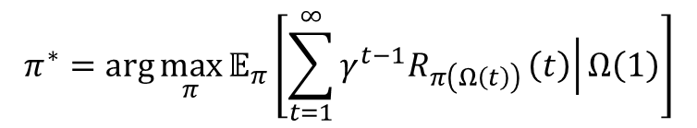

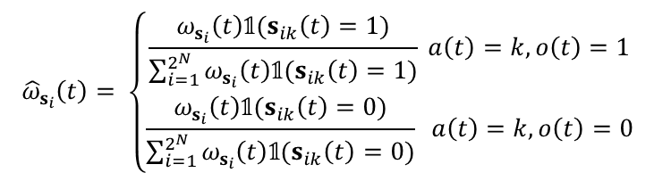

Problem
Formulation
POMDP model
$${\hat{ω}}_{s_{i}}\left(t\right)= \left\{\begin{aligned}\frac{ω_{s_{i}}\left(t\right)𝟙{(s}_{ik}\left(t\right)=1)}{\sum_{i=1}^{2^{N}}{ω_{s_{i}}\left(t\right)𝟙{(s}_{ik}\left(t\right)=1)}} a\left(t\right)=k, o\left(t\right)=1 \\ \frac{ω_{s_{i}}\left(t\right)𝟙{(s}_{ik}\left(t\right)=0)}{\sum_{i=1}^{2^{N}}{ω_{s_{i}}\left(t\right)𝟙{(s}_{ik}\left(t\right)=0)}} a\left(t\right)=k, o\left(t\right)=0\end{aligned}\right.$$
$𝟙$(.) is the indicator function
Combining the newly updated belief vector $\hat{Ω}\left(t\right)$for time slot t with the system transition matrix $P$, the belief vector for time slot $t+1$ can be updated as $Ω(t+1)$ = $\hat{Ω}(t)P$.
Reward : If the channel quality is good, the transmission succeeds and the user receives a positive reward (+1), else the user transmission fails and there is a negative reward (−1).
Policy $π$ : Policy is a function that maps the belief vector $Ω\left(t\right)$to a sensing action $a(t)$ at each time slot t.
$$π : Ω\left(t\right)→a(t)$$
Our objective is to find a sensing policy $π^{∗}$ that maximizes the expected accumulated discounted reward over infinite time
$$π^{∗}=arg\max_{π}{𝔼_{π}}\left[\sum_{t=1}^{∞}{γ^{t−1}R_{π\left(Ω\left(t\right)\right)}\left.\left(t\right)\right|Ω\left(1\right)}\right]$$

Slide 6
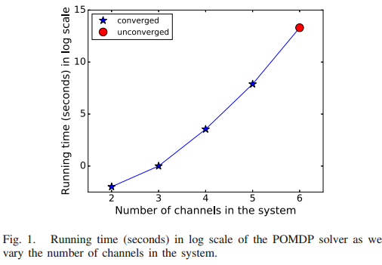
Problem
Formulation
however the dimension of the belief vector is exponentially large in the number of channels.
Even worse, the infinite size of the continuous belief space and the impact of the current action on the future reward makes POMDP PSPACE-hard. (It's too difficult, calculating)
When the number of channels is higher than 5, we find that the POMDP solver can not converge after a long interval, and it gets terminated when the run-time exceeds the time limit.
All these factors make it impossible to find the optimal solution to the problem in general.
Many existing works attempt to address this challenge of prohibitive computation by considering either simpler models or approximation algorithms
Myopic Policy
, Whittle Index Based Heuristic Policy
<Gilbert-Elliot channels>
<restless multiarmed bandit problem (RMAB)
Assume that channels are independent>
The Myopic policy and the Whittle Index policy are easy to implement in practice and have polynomial run-time, however they achieve optimality only under certain conditions when channels are independent.

Slide 7
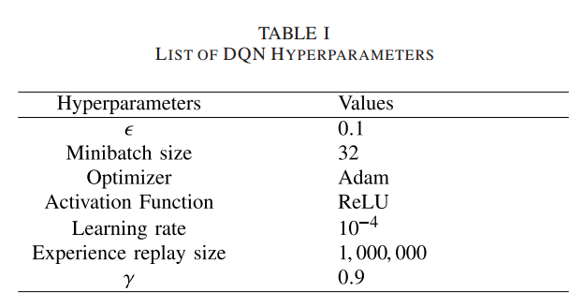
DQN,
Simulation
DEEP REINFORCEMENT LEARNING
When channels are correlated and system dynamics are Unknown.
Approach → model free, Deep Q-Learning
Simulation
* Performance on the fixed-pattern switching pattern model
* Real Data Trace
* The practical issue of synchronization between the sender and receiver of the system
* Performance on the changed-pattern switching pattern model
Notes:
solving a POMDP in a large state space is always a bottleneck as the dynamic programming method has exponential time complexity (as explained in Section III) and the heuristic approaches do not have any performance guarantee.

Slide 8
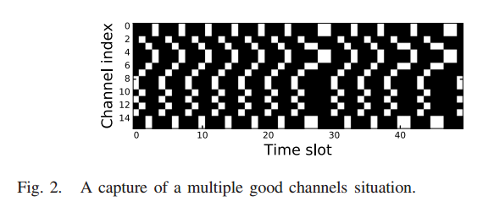
Problem
Formulation
* Performance on the fixed-pattern switching pattern model
Optimal policy for known fixed-pattern channel switching.
We consider a correlated channel model that we refer to as fixed-pattern channel switching, in which all the N channels in the system can be divided into several independent subsets and these subsets take turns to be activated following a fixed pattern
Specifically, we assume all channels in one currently activated subset are good and all channels in inactivated subsets are bad.
At each time slot, with a known probability p (0 ≤ p ≤ 1) the next following subset is activated, and with probability 1 − p the current subset remains activated.
We assume the activation order of the subsets is known, fixed, and will not change over time.
we investigate the fixed-pattern channel switching model with 16 channels are evenly divided into several subsets that take turns to become available with a switching probability fixed at p = 0.9.
In Fig. 2, we provide a pixel illustration to visualize how the states of channels change.
: channel is Bad
: channel is Good
Notes:
solving a POMDP in a large state space is always a bottleneck as the dynamic programming method has exponential time complexity (as explained in Section III) and the heuristic approaches do not have any performance guarantee.

Slide 9
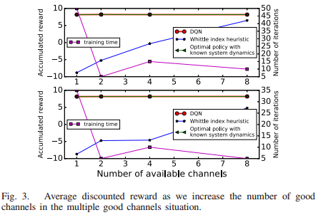
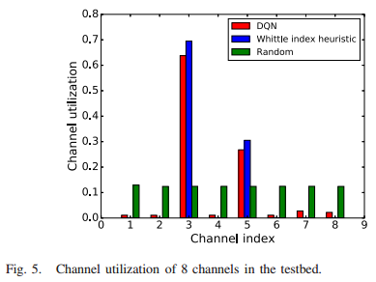
Simulation
The 16 channels in the system are in order and the subsets are activated in a sequential round-robin order in the upper graph in Fig. 3,
Performance
(reward)
Number of iterations
(time)
Number of good channels
* Real Data Trace
We use real data trace collected from our indoor testbed Tutornet to train and evaluate the performance of DQN on Fig. 5. Channel utilization of 8 channels in the testbed. real systems. The testbed is composed of TelosB nodes with IEEE 802.15.4 radio.
The transmitter continually transmits one packet rapidly to each one of the 16 available channels within one time slot and the synchronized receiver records the successful and failed attempts, with the only interference coming from surrounding WiFi networks that show high dynamic variability
we ignore 8 good channels and use only the data trace from the remaining 8 channels that show significant WiFi interference.
The average accumulated discounted reward from each policy is listed in descending order:
0.947 (DQN), 0.767 (Whittle Index) and −2.170 (Random Policy).
Notes:
solving a POMDP in a large state space is always a bottleneck as the dynamic programming method has exponential time complexity (as explained in Section III) and the heuristic approaches do not have any performance guarantee.

Slide 10
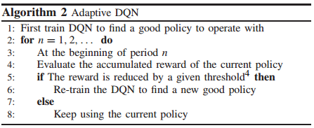
Simulation
* The practical issue of synchronization between the sender and receiver of the system
One approach is to run the same structured DQNs at the sender and the receiver separately.
The channel mismatch problem can still happen when an ACK/NAK is lost, which not only causes loss of communication, but also results in different learned DQN models at the sender and receiver that give different channel selection policies.
The sender keeps sending this channel mismatch time information until an ACK being received.
The receiver can then set its DQN model as well as its training dataset back to the state right before the channel mismatch happened. (Re-train the DQN)
* Performance on the changed-pattern switching pattern model
The main idea is to let DQN periodically evaluate the performance (i.e., the accumulated reward) of its current policy, and if the performance degrades by a certain amount, the DQN can infer that the environment has changed and start re-learning.
To evaluate this enhancement, we make the system initially follow one of the fixed-pattern channel switching cases, and after some time it changes to another case
Notes:
solving a POMDP in a large state space is always a bottleneck as the dynamic programming method has exponential time complexity (as explained in Section III) and the heuristic approaches do not have any performance guarantee.

Slide 11
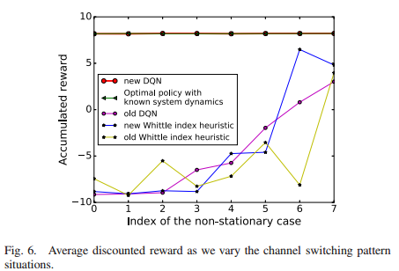
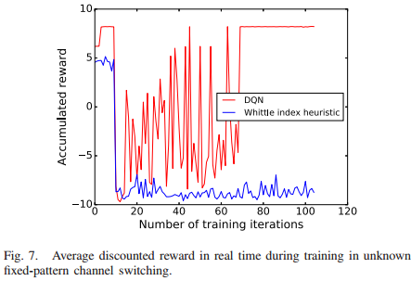
Simulation
* Performance on the changed-pattern switching pattern model
As can be seen, DQN is able to find an optimal policy for the new environment as the genie optimal policy does, while Whittle Index heuristic, even manually tuned, does not.
Performance
(reward)
Number of good channels
We provide the real-time accumulated reward during
the learning process of DQN and the Whittle Index heuristic in one of the above pattern changing situations in Fig. 7.
Change situation
DQN can detect the change and starts re-learning.
Notes:
solving a POMDP in a large state space is always a bottleneck as the dynamic programming method has exponential time complexity (as explained in Section III) and the heuristic approaches do not have any performance guarantee.

Slide 12
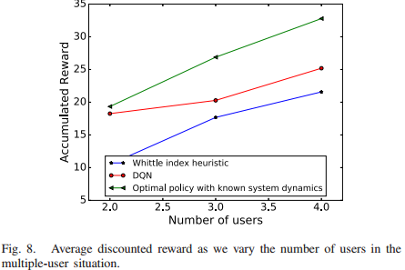
Future work
* multiple-users
we use the same DQN structure consider the multiple-users situation in a smaller system that contains 8 channels where at any time slot 6 channels become good and channel conditions change in a round-robin pattern.
* Other method
Other deep reinforcement learning approaches, such as Deep Deterministic Policy Gradient (DDPG) will be studied in future to tackle the large action space challenge
* Each user can learn
when the number of users in the network becomes large, the above proposed centralized approach becomes too computationally expensive.
In future, we plan to study a more practical distributed approach where each user can learn a channel selection policy independently.

